Slide 1
Collections in JAVA
By - Kalyani Shelgaonkar

Slide 2
Contents
Introduction
Collection Interface methods
Retrieving Elements from Collection
ArrayList Class
Vector Class
TreeSet Class
Queue
HashMap Class
Advantages of Collections

Slide 3
What is Collection?
Collection is a container of Objects, it groups many objects into one single one
Came into existence since Java 1.2
Resides under java.util package

Slide 4
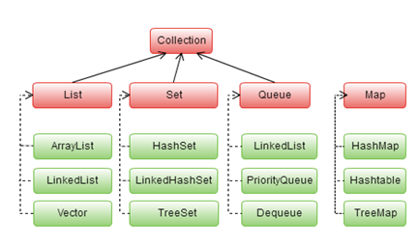

Slide 5
Collection Interface methods
int size();
boolean isEmpty();
boolean add(Object Element);
boolean remove(Object Element);
boolean containsAll(Collection c);
boolean addAll(Collection c);
boolean removeAll(Collection c);
void clear();

Slide 6
Retrieving Elements from Collection
Iterator Interface
List Iterator Interface
Enumeration Interface
Iterating using Enhanced For Loop

Slide 7
ArrayList Class
Grows Dynamically
Provides more powerful insertion and search mechanisms than arrays
Gives faster Iteration and fast random access
Syntax:
ArrayList<DataType> obj = new ArrayList<Data Type>();

Slide 8
Vector Class
Implements dynamic array
Synchronized
Similar to ArrayList
Syntax:
Vector<DataType> obj = new Vector<DataType>();

Slide 9
TreeSet Class
Doesn’t allow Duplicates
It iterates in Sorted Order
Not Synchronized
Syntax:
TreeSet<Datatype> obj=new TreeSet<Datatype>();

Slide 10
Queue
Two Implementations:
1.Linked List
2.Priority Queue
Syntax:
Queue Obj=new LinkedList();
Queue Obj=new Priority List();

Slide 11
HashMap Class
Works on the principle of Hashing
Gives unsorted and unordered Map
Allows one null key and multiple null values in a collection
Syntax:
HashMap<KeyType, ValueType> obj = new HashMap<KeyType, ValueType>();

Slide 12
Advantages of Collections
Reduces Programming Efforts
Increases Programming speed and quality
Reduces effort to design new APIs
Helps to reuse the code

Slide 13
THANK YOU!

